Slide 1
intro to web design II
paul kisambira

Slide 2
course overview
Review of HTML CSS & JAVASCRIPT
intro to web application development and tools
PHP basics
PHP abstractions and data structures
AJAX
SECURITY AND STATE MANAGEMENT
DESIGN PATTERNS

Slide 3
World Wide Web (WWW)
At a minimum, a website requires:
A set of files, e.g. HTML files
A piece of software residing on a computer connected to the internet which can display these files .. Web server
Visitor’s computer called the client, which has software capable of displaying the web files.

Slide 4
WWW and Client-Server model
Request
e.g. “Get me a webpage”
Web
Browser
Web
Server
Resources:
Databases
Application
Client
Response
Server
e.g. “here’s the web page”

Slide 5
WWW
In early days of WWW, simple relationship between the browser and a distant server
User requests a web page via the browser
Server received request, server sent back the page that you wanted
Web sites were often limited to ‘brochureware’
static pages
every user sees same pages
Web sites heavily reliant on HTML to provide functionality

Slide 6
WWW
Requirement grew for more sophisticated websites with dynamic content
e.g. search engines, bulletin boards, shopping sites, personalisation ---→ Users see different pages, depending on user input
HTML and client technology insufficient
Web pages need to be generated ‘on the fly’ or dynamically
A range of server-side technologies now available, such as JSP, ASP, PHP, Cold Fusion, CGI

Slide 7
WWW – Client Server model
World Wide Web uses Client Server Model
Client (browser) sends request to server (web server) for resource ..
Web server accesses resource
Web server responds to client with resource
Browser/ web server communication:
Need a protocol to communicate
HTTP (Hyper Text Transfer Protocol)

Slide 8
Client side versus server side processing
Need to understand the difference as each one has limitations and specific purposes
Client side processing occurs on the client machine (i.e. machine that has requested the web page)
Server side processing occurs on the server

Slide 9
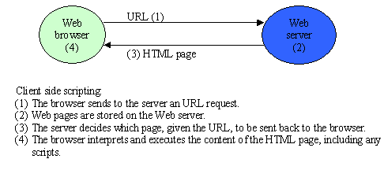
Client side processing
Can perform functions without revisiting server –
e.g. validation of user input on a form

Slide 10
Client technologies
Client side technology (e.g. java script, HTML) is run on the client machine
Used for :
Presentation (I.e. text/images etc)
Validation of user input
Enhanced interactivity e.g. graphics, buttons
Reduces the number of visits to the server – (e.g. user input can be validated without having to revisit the server)

Slide 11
Example
HTML>
<HEAD>
<TITLE>Example error message display </TITLE>
<SCRIPT> type = “text/javascript”>
<!—-
document writeln (“<h1>you have not entered your name”<h1>2);
// - ->
</SCRIPT>
</HEAD>
<BODY> <BODY BGCOLOR="white"> <H1 align="center">Simple Test</H1> … etc

Slide 12
Limitations of client-side technologies
Cannot implement functionality that requires returns customised information to the user – e.g. database searches
Client machine/device must be sufficiently powerful (mobile devices)
Need to ensure browser support client software
Source code is visible

Slide 13
Server-Side functionality
Server-side functionality needed to:
generate dynamic content from a database (as opposed to static HTML pages)
Process user requests/interactivity
Retrieve information from users
Manage sessions.. and more.

Slide 14
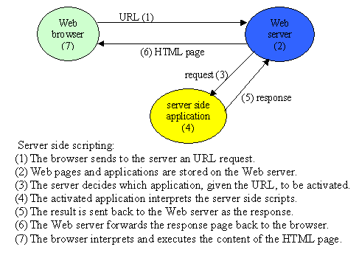
Server side processing

Slide 15
Common Server Technologies
Server Side Technologies are those that run at the server side. Includes the following:
CGI – Common Gateway Interface
Java Servlets
ASP – Active Server pages
JSP – Java Server pages
PHP – Personal Home page
Cold Fusion
SSJS - Server side javascript
Server extension APIs
Server side Scripting

Slide 16
Server-Side scripting
Servers-side technologies include a range of scripting technologies
Scripting: Where HTML is mixed with program code
Only a small portion of the page is generated and templates or skeleton contain the headers, footers and other format information.
The page contains scripting information - the web server has built-in interpreter to make the modifications to the page based on the scripting information
Common sever-side scripting technologies are:
Active Server Pages (microsoft), Java Server Pages (sun)
PHP, Cold Fusion

Slide 17
Server-Side scripting
Scripts Reside on server
Greater flexibility/functionality supported (e.g. database access
Runs exclusive on server -> not concerned with client browser support. Result is sent over the network to the client
Script/code not visible to client – only HTML and client-side scripts sent to client machine

